Slide 1

Automated Lunchbox Queue Management and Heating System
02

Slide 2

Problem Statement
The Problem:
Shared microwaves in offices, schools, and factories cause long queues.
Manual queuing wastes break time and creates user frustration.
No structured way to manage microwave usage in high-demand areas.
10

Slide 3
Solution
The Solution:
A conveyor system to manage lunchbox queue positions automatically.
Ultrasonic sensors detect and track lunchbox placement.
A robotic arm punches heating time into the microwave.
A web interface allows users to view their slot and input time remotely.
Real-time monitoring and reduced wait time.
06

Slide 4
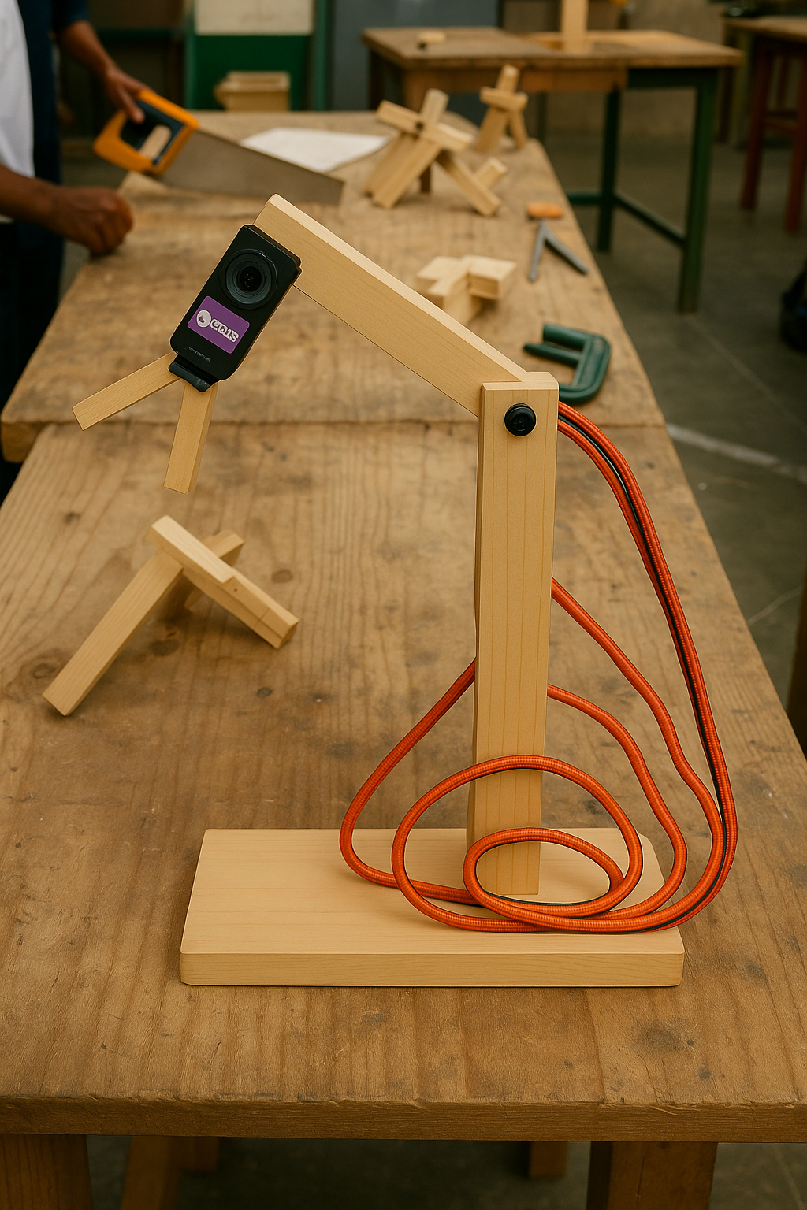
Write what your product does here
Product
Features:
Conveyor mechanism with 3 slots (prototype).
Ultrasonic sensors connected to ESP32 detect slot occupancy.
Robotic arm made with carpentry wood and DS3218 servo motors.
Web interface sends heating time input to ESP32.
LCD displays slot availability in real-time.
04

Slide 5

Target Market
Target Users:
Factories with large workforces
Office buildings with shared kitchens
Universities and student cafeterias
Event or conference venues
Market Need:
Time-saving automation in lunch zones
Efficient microwave usage systems
14

Slide 6
Market Size
Industry Relevance:
The smart appliance market is projected to reach $76.4 billion by 2025 globally (Statista).
Shared kitchen and office automation solutions are rapidly growing, especially in tech-driven workplaces.
Estimated Market Segments:
Corporate Offices: Thousands of large-scale offices across South Africa and globally with shared breakrooms.
Universities and Colleges: Student centers and dormitories with limited microwave access.
Factories and Industrial Sites: Shift workers relying on centralized heating points during breaks.

Slide 7
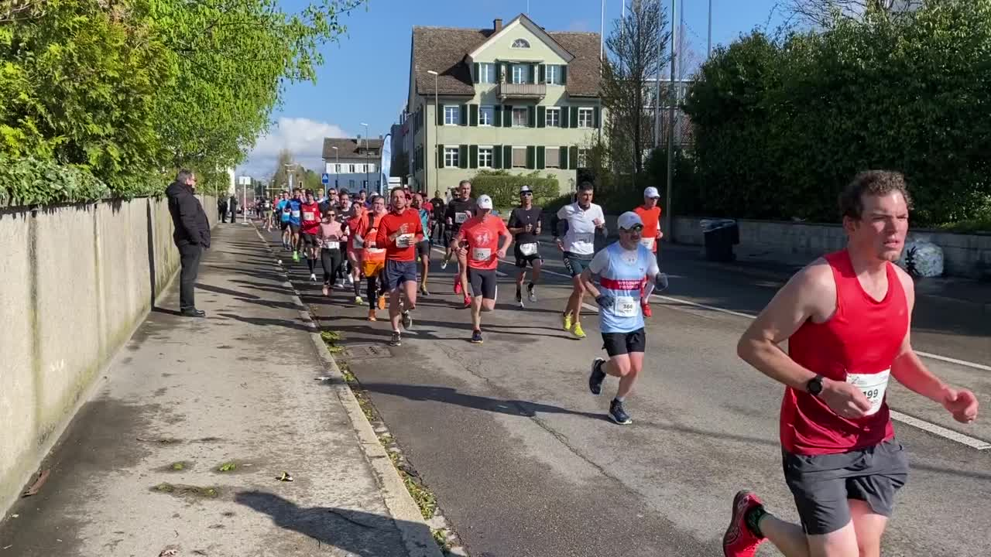
Competitors
Existing Systems:
Manual microwave usage
Basic queue scheduling apps
Why We’re Different:
Fully physical automation of heating process
Real-time slot tracking and robotic interaction
No need for users to physically queue
23

Slide 8
Project Traction
Tasks
Month 1
Month 2
Month 3
Month 4
Month 5
Research & Planning
Build conveyor prototype
Assemble robotic arm
Integrate ESP32 with sensors
Develop and link web interface
Testing, feedback collection
23

Slide 9
Business Model
Low-cost installation in shared spaces
Monthly licensing for software and maintenance
Custom-built systems for organizations
Profit through hardware setup + service contracts
23

Slide 10
Go To Market
Initial launch in universities and coworking spaces
Partner with local tech labs or engineering incubators
Live demos to showcase effectiveness
Reach facilities managers and campus coordinators

Slide 11
Social Impact
Addresses the Following SDGs:
SDG 9: Industry, Innovation and Infrastructure
SDG 8: Decent Work and Economic Growth
SDG 12: Responsible Consumption and Production
SDG 4: Quality Education (through hands-on tech learning)

Slide 12
Our Ask
  What We Need:
Funding for expanding prototype to more slots
Access to better lab equipment and 3D-printed parts
Opportunities to pilot the system in real environments
Use of Funds:
Purchase more servo motors and sensors
Improve web interface and mobile access
Build a more polished version of the robotic arm

Slide 13
Thank you!
Elias Metsing
Phone: 072 677 2184
Email: metsingelias@gmail.com
17

